Slide 1
Angle manager
Tianjin University
Sensors and Sensoring
Denche Thibaud
Dolphens Nicolas

Slide 2
Summary
Concept, materials and assembly
Softwares and code architecture
Functioning of the code

Slide 3
Concept, materials and assemby

Slide 4
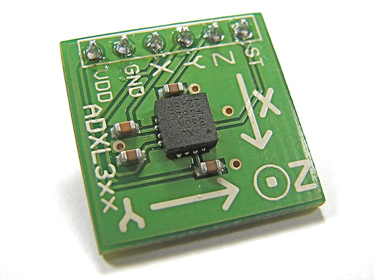



Concept, materials and assembly

Slide 5
Concept, materials and assembly
1 Galileo card
1 Fan
1 Accelerometer
6 Straws drink
3 Toothpick
2 Pieces of paper
1 Pen
1 Light
3 Hangers
1 Adhesive tape
Tens wires
Calm and serenity*
* : Otherwise, plan the double of every component. Triple if you’re really not calm.

Slide 6

Concept, materials and assembly

Slide 7
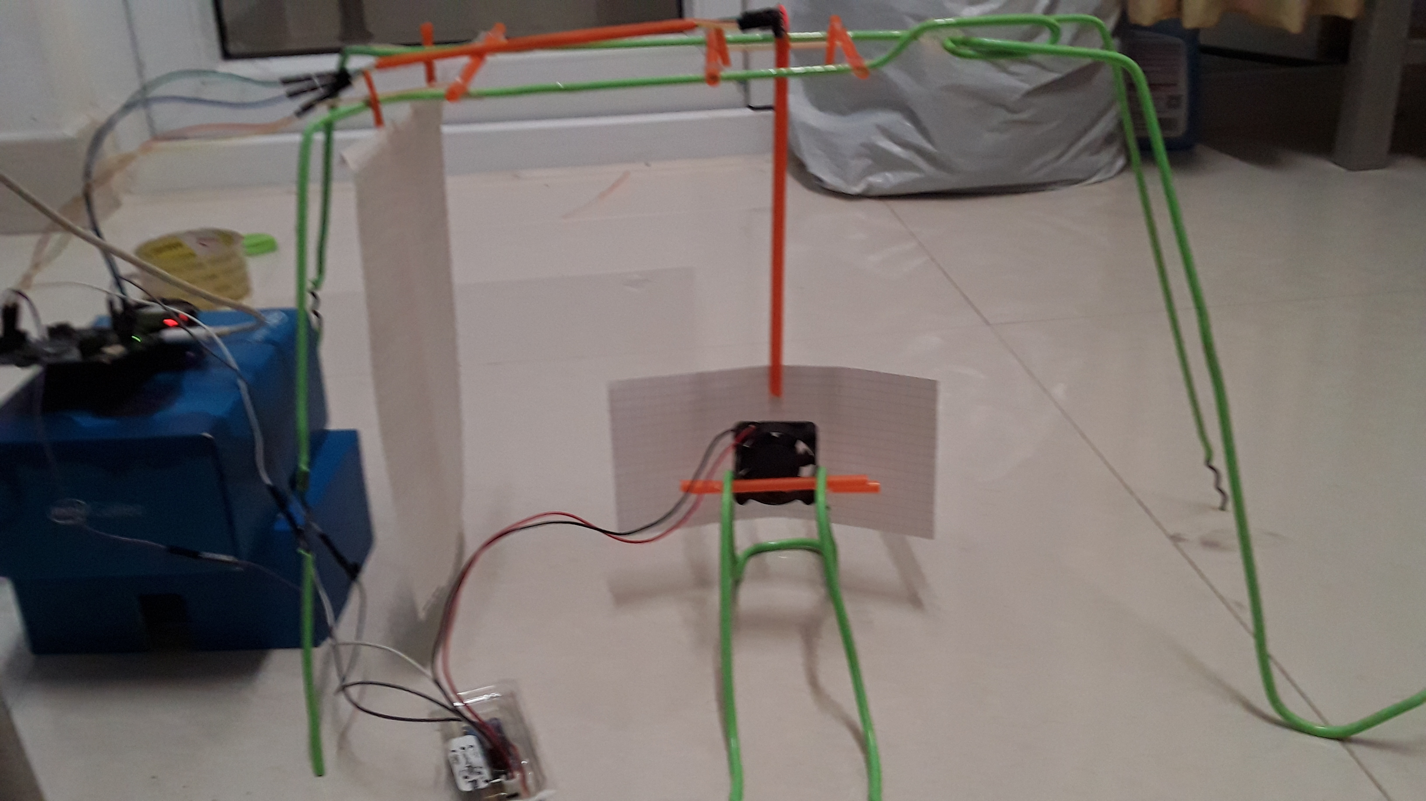
Concept, materials and assembly

Slide 8
Softwares and code architecture

Slide 9

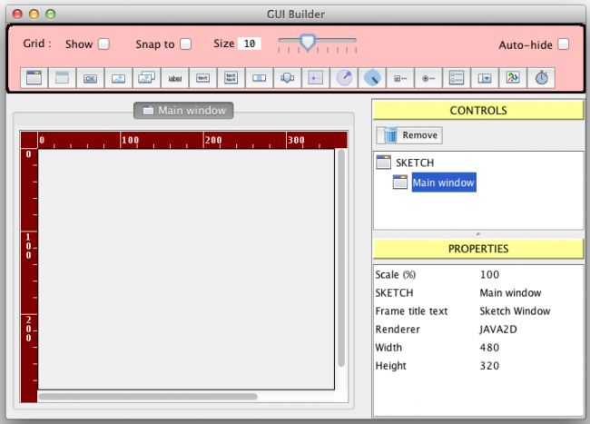

Softwares and code architecture
Softwares :

Slide 10
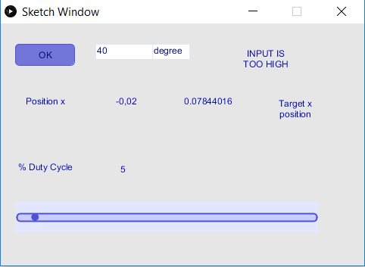
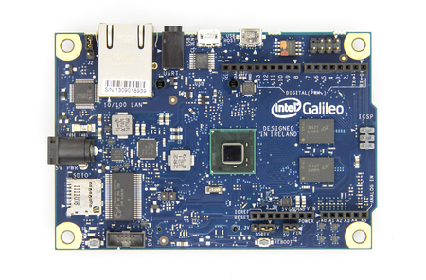
Softwares and code architecture
Ok button

Slide 11
Softwares and code architecture
Calculate the value the accelerometer need to reach the angle
Start the fan speed at 10 * the angle asked by the user
Mobile average of the X position of the accelerometer and send it to the GUI
Communicate everything to the GUI and read thanks to circular buffer (loop buffer)
Increase the value of the duty cycle every 300ms
As soon as the angle is reached, keep the same value for the duty cycle and keep sending the mobile average of the X position of the accelerometer to the GUI

Slide 12
Softwares and code architecture
Keep reading on the serial port thanks to a circular buffer (loop buffer)
Update the GUI with every values received (X position of the accelerometer and duty cycle of the fan in percentage)
Possibility to enter a new angle and press the ok button to reach another angle
Display a message in the text box message if the angle is reached or not
The duty cyle is readable on the slidebar

Slide 13
Functioning of the code

Slide 14
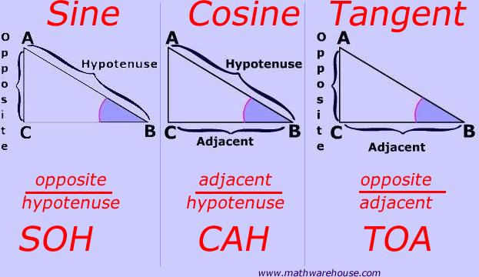
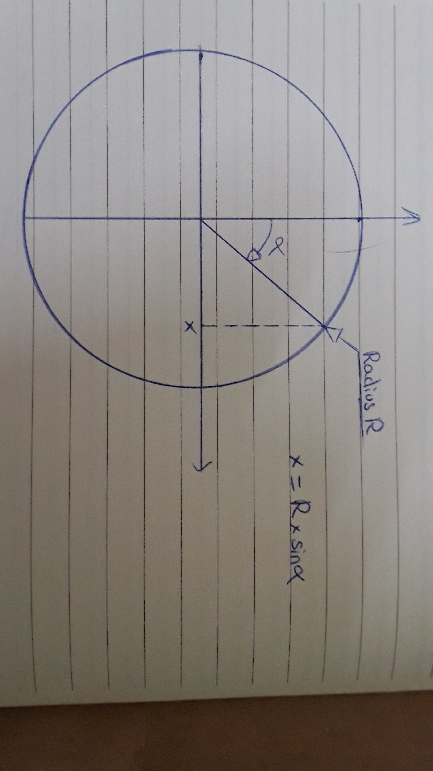
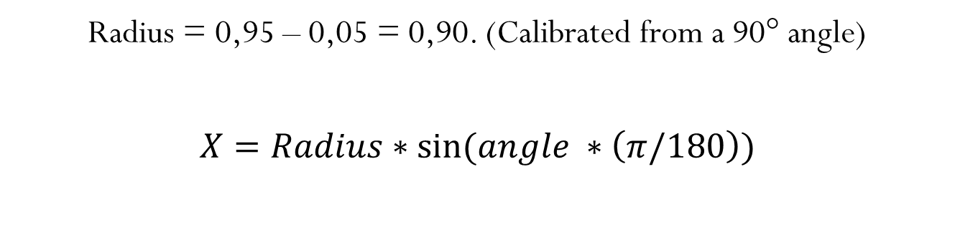
Functioning of the code
Radius = 0,95 – 0,05 = 0,90. (Calibrated from a 90° angle)
$$X=Radius∗\sin{(angle ∗\left(π/180\right))}$$

Slide 15

Functioning of the code
Example :
Angle entered in the GUI -> 34°
$X=0,90∗\sin{(34 ∗\left(π/180\right))}$ = 0.53 (rounded value)
When the X value of the accelerometer will be 0,53, the angle will be reached.

Slide 16

Functioning of the code
How to keep the angle asked by the user once it’s reached ?
PWM method (Pulse with modulation)
$\% duty cyle=\left(\frac{TON}{TON+TOFF}\right)∗100$
analogWrite(digitalPin, (analogRead(analogPin) / 4))

Slide 17
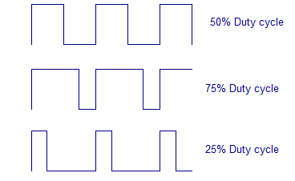
Functioning of the code
Examples of duty cycles :

Slide 18
Functioning of the code
Finally :
If the angle can’t be reached, an error message will be displayed in the text box
If the angle have been reached, a confirmation message will be display displayed in the text box
The user can change the angle when he wants without restarting the program
Because of the power of the fan used, we are not able to make every angles

Slide 19
Problems encounters
The structure was really hard to built, we had to make something as much stable as possible to avoid resistance and frictions.
A lot of researches had to be done, particulary on PWM method and communication on the port.
The quality of the materials used make the result of the project less exact than what it should be.

Slide 20


